Slide 1
Vending Machine Analysis
By: Omar, Saif, Andrew, Ahmed, Aman

Slide 2
TABLE OF CONTENTS
01
02
Excel Data
Power BI Implementation
03
04
Python Mapping
Python Predictive Analysis

Slide 3

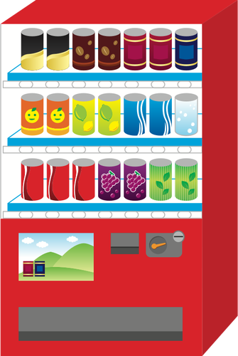
Introduction & Problem Statement
How many of you have used vending machines this year?
Did you ever wonder how companies know when to restock a vending machine?
ABC Vending is a small vending machine company with 5 vending machines across Mississauga
They Sell Four Categories of Products
Carbonated Beverages
Food
Non Carbonated Beverages
Water
In order to help ABC Vending with their business
Executive Dashboard
Logistic Mapping - Supply Chain
Predictive Modelling Through Python

Slide 4
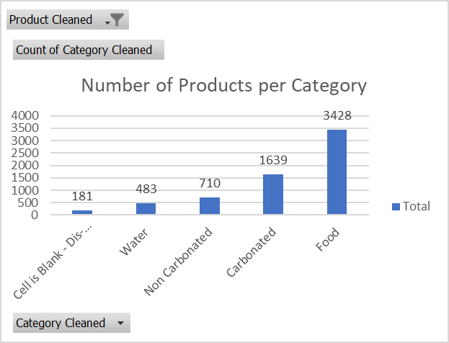
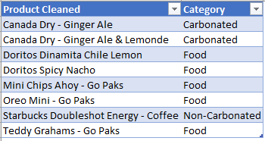
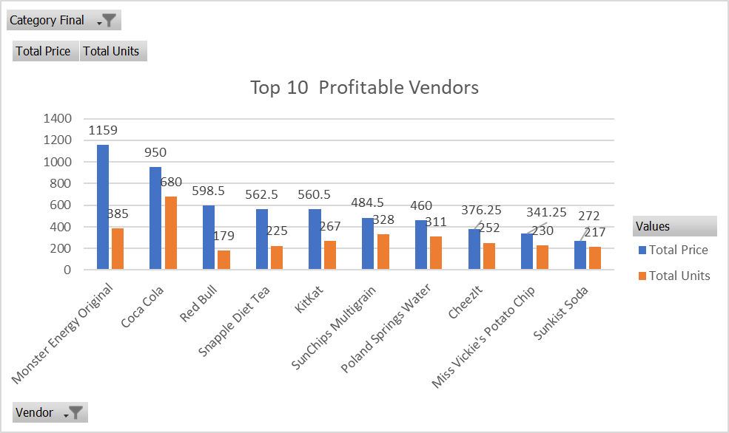
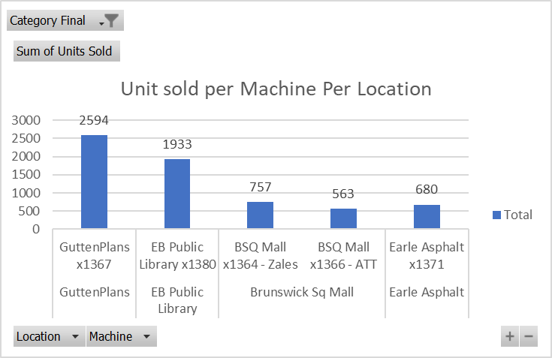
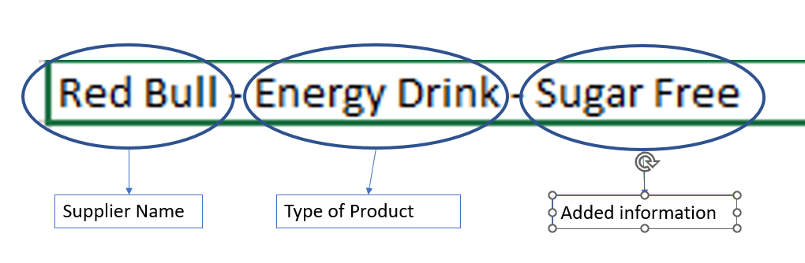
Excel Data Analysis
The team used excel to slice and dice different data analytics techniques to achieve both exploratory data analysis and predictive modelling

Slide 5
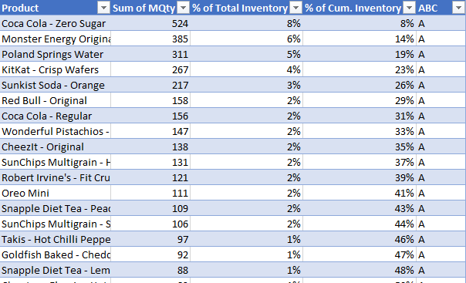
ABC Analysis
For predictive modelling we utilized the ABC Analysis to use historical data to predict what SKUs can be categorized based on the % of Cumulative Inventory:

Slide 6
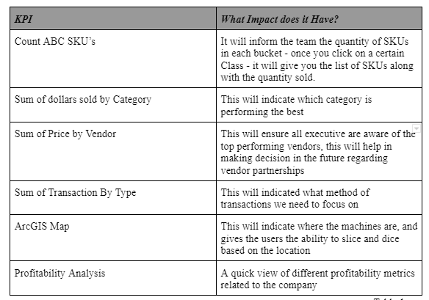
Excel to PowerBI Transition
We used both the exploratory data and predictive modelling done in Excel to create various KPIs that would help a Executive staff member make decision regarding the business in a strategic and astute manner.
To Access the Dashboard - Click Here.

Slide 7
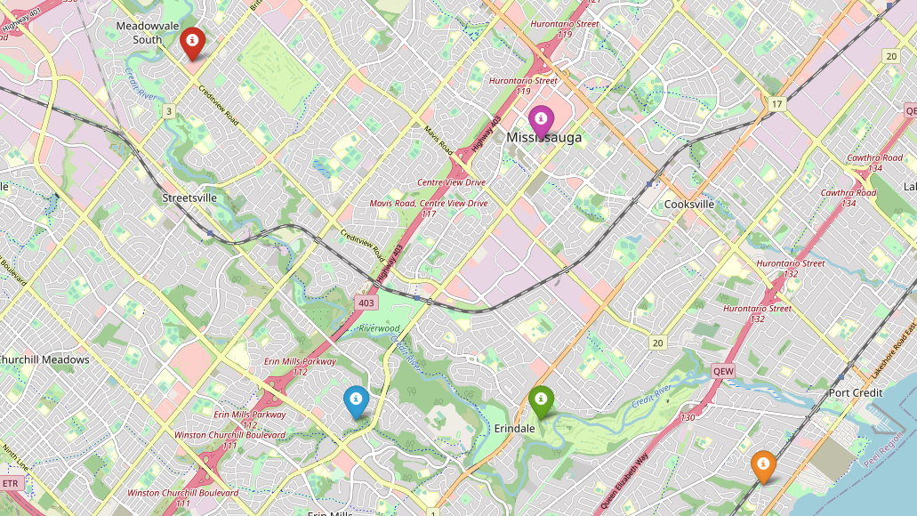
Python Programming: Mapping
Goal is to determine optimal geo-spatial coordinates for vending machines and the optimal positioning for the warehouse facility
The vending machines were given arbitrary longitudes and latitudes
Each location was given a weight to determine the warehouse location
Red Marker (Brunswick Sq Mall), Purple Marker (Earle Asphalt), Blue Marker (EB Public Library), Yellow Marker (GuttenPlans), Green Marker (Warehouse)
Figure: Vending Machines and Warehouse Mapped Out Using Folium Library

Slide 8
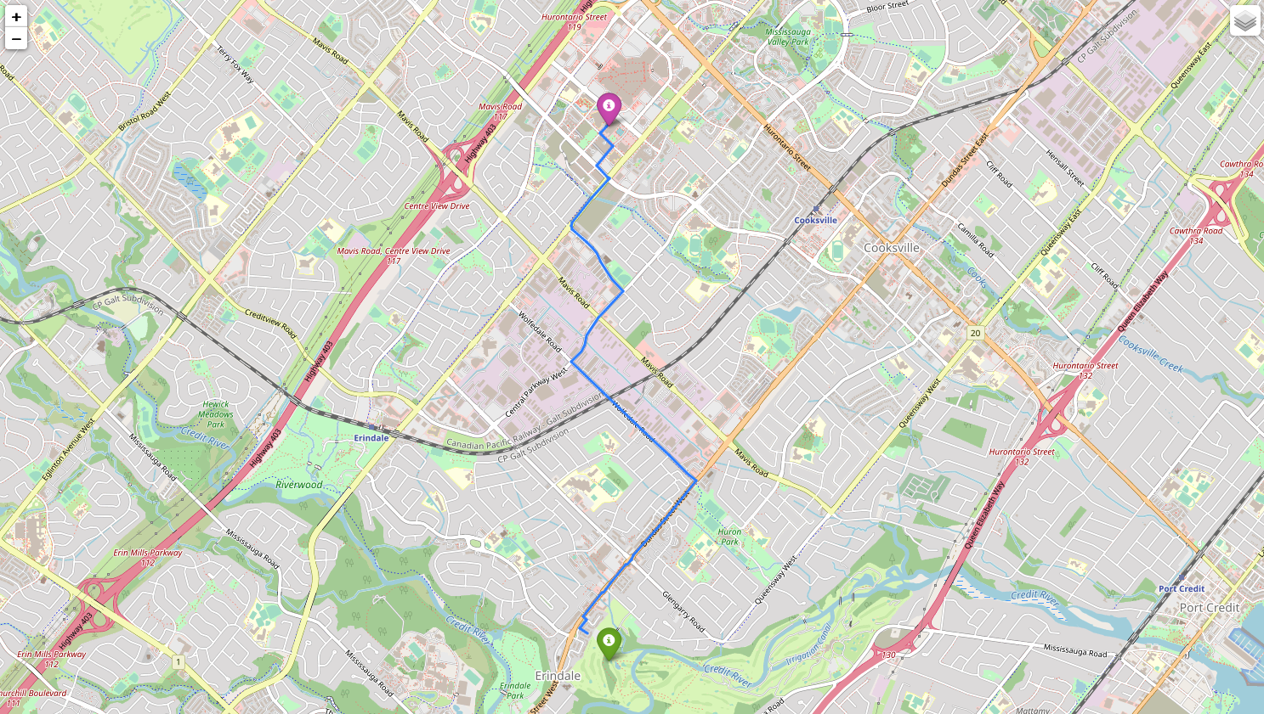
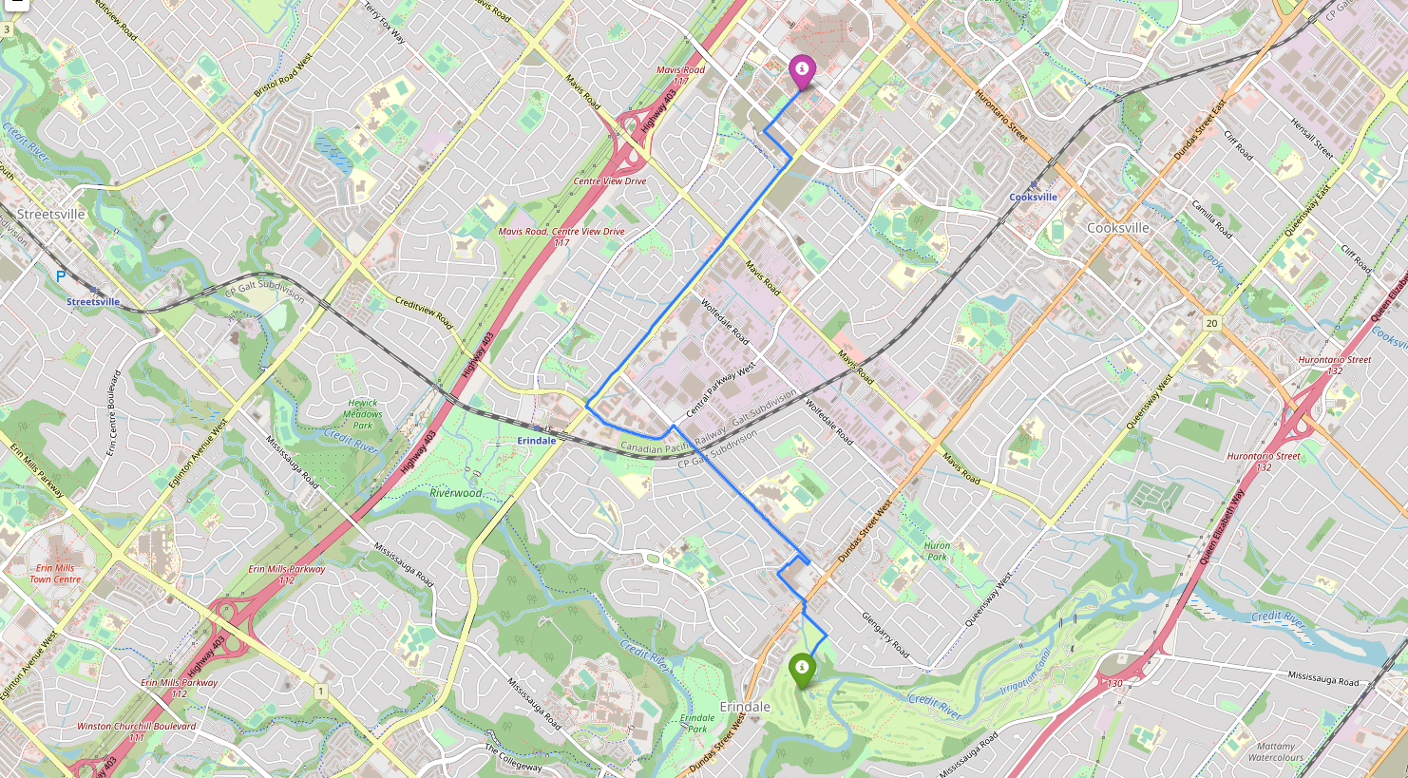
Python Programming: Mapping pt. 2
Example presented is the optimal route between the Warehouse facility and Earle Asphalt:
Distance between two locations found to be 4.35 km or 2.70 miles
For drive mode assuming 50 km/h average speed it would take 5.22 minutes
Figure: Optimal Route Using ‘drive’ mode
Figure: Optimal Route Using ‘bike’ mode

Slide 9
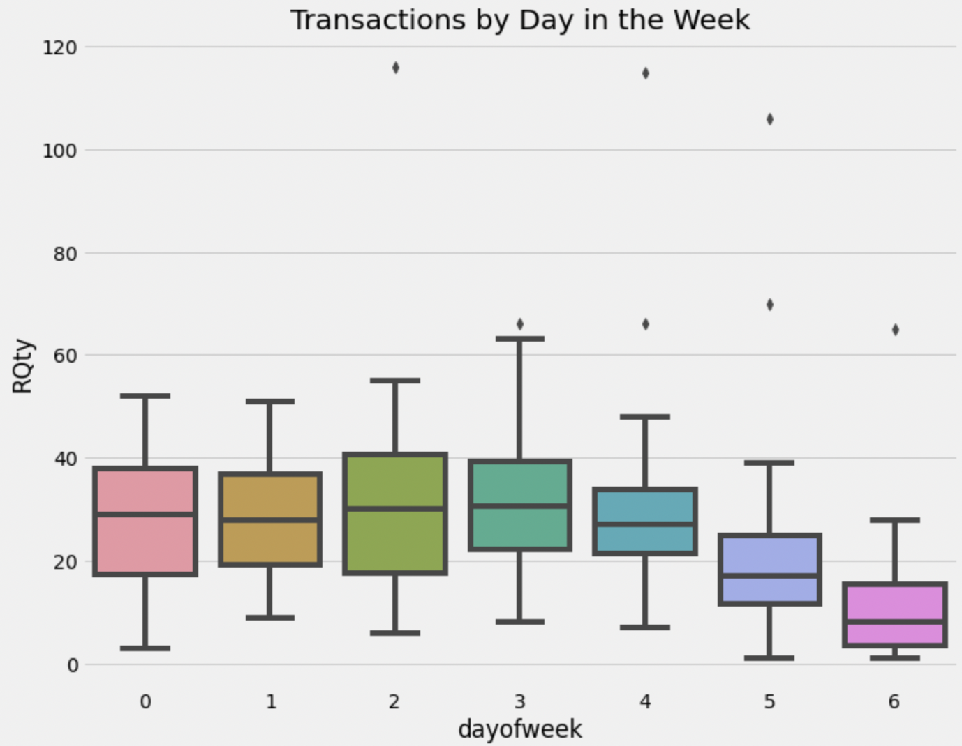
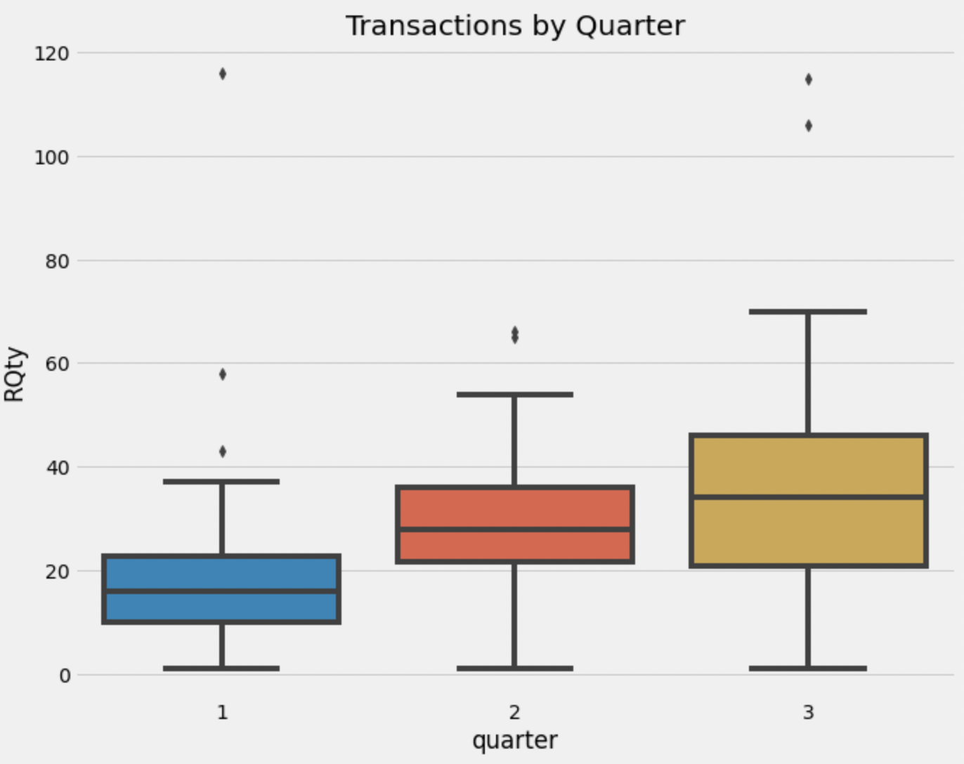
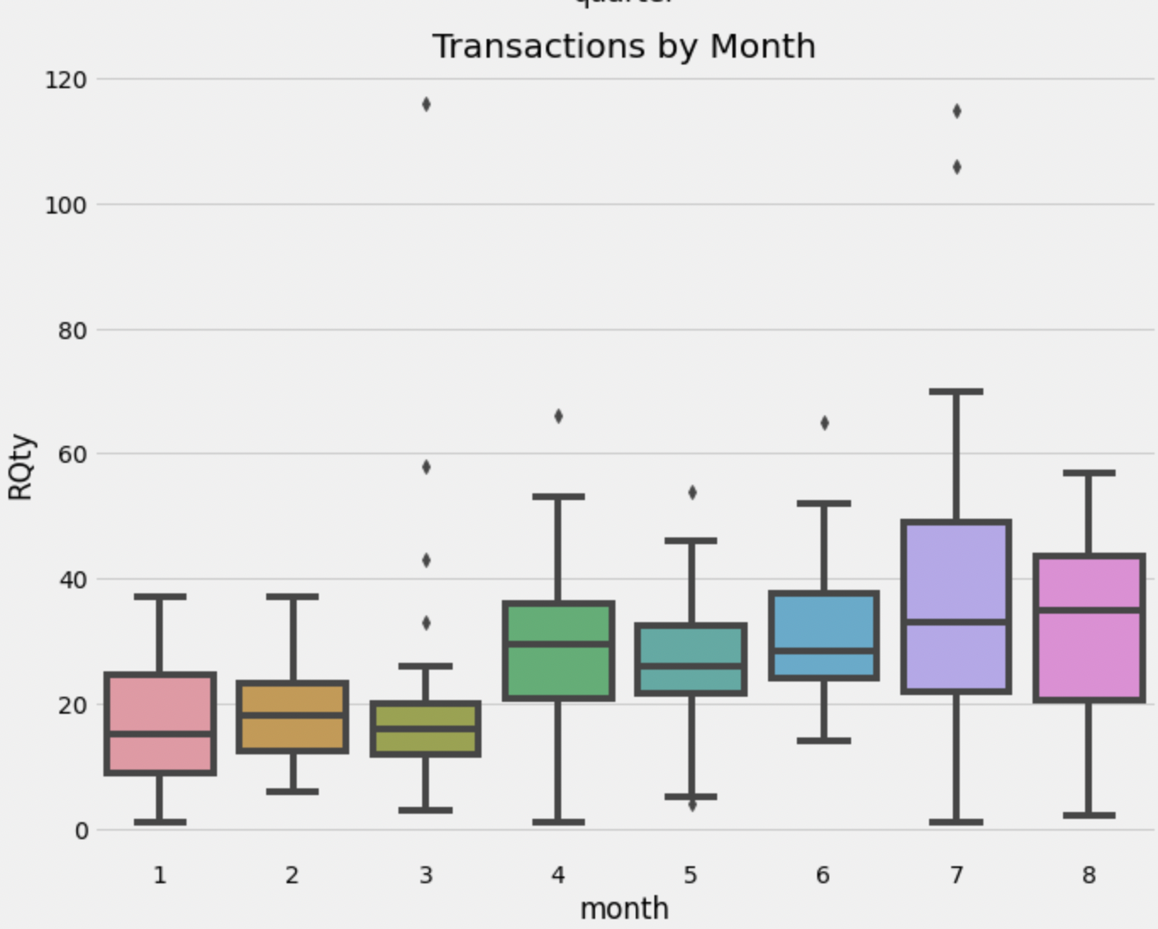
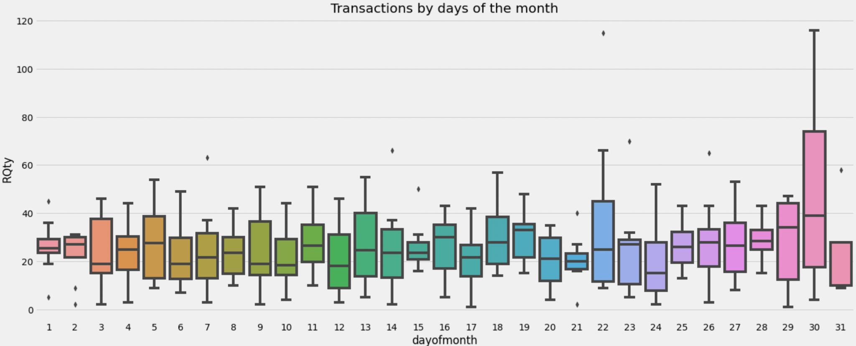
Python Initial Analysis

Slide 10
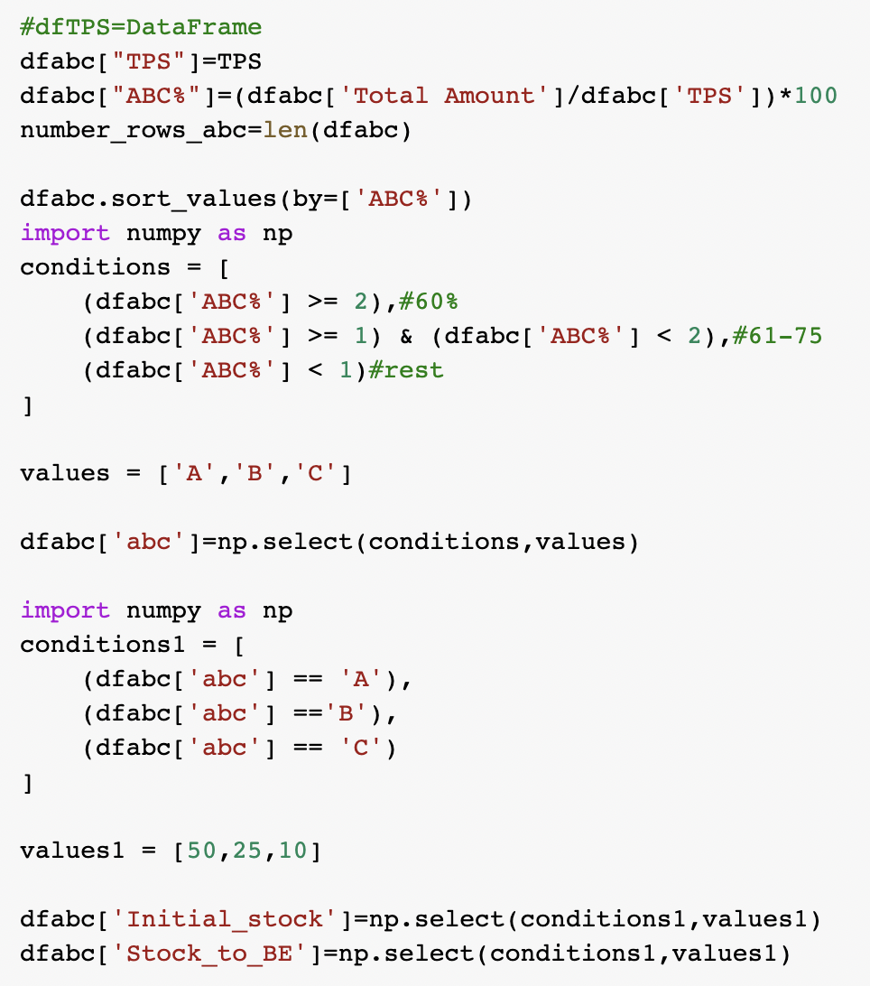
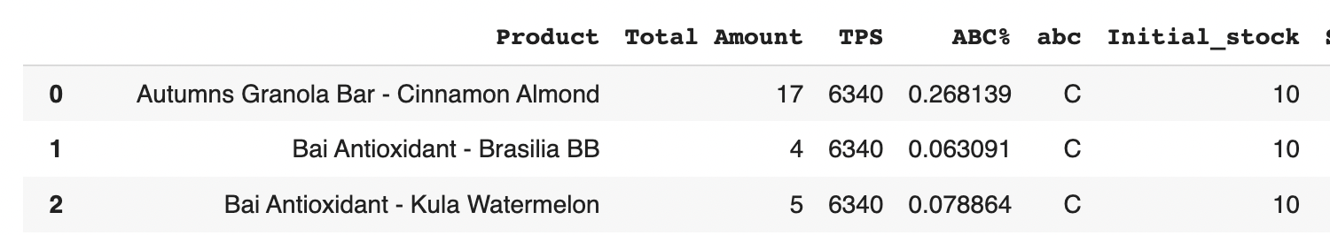
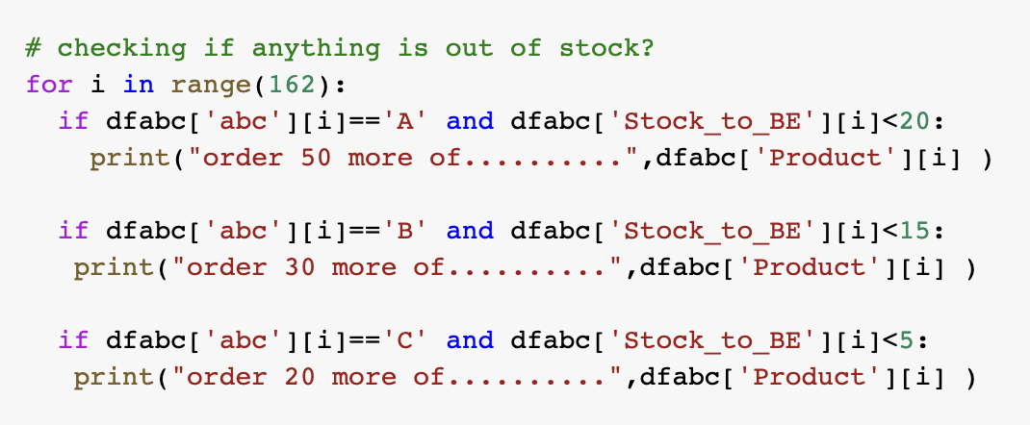
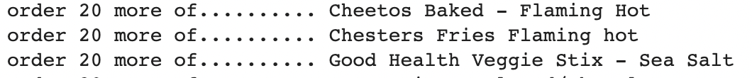
Python Automatic Inventory System

Slide 11
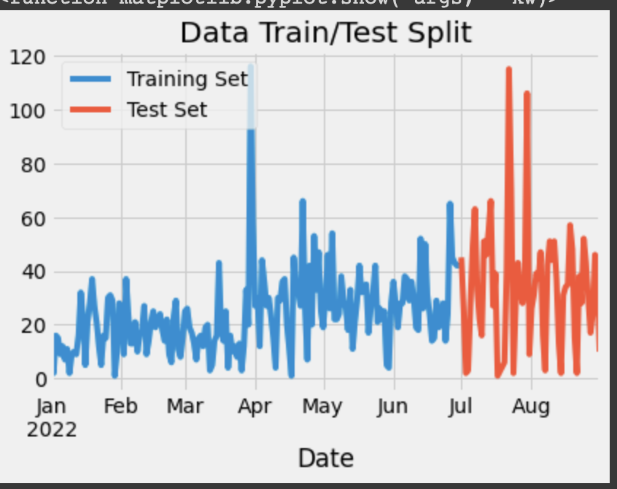
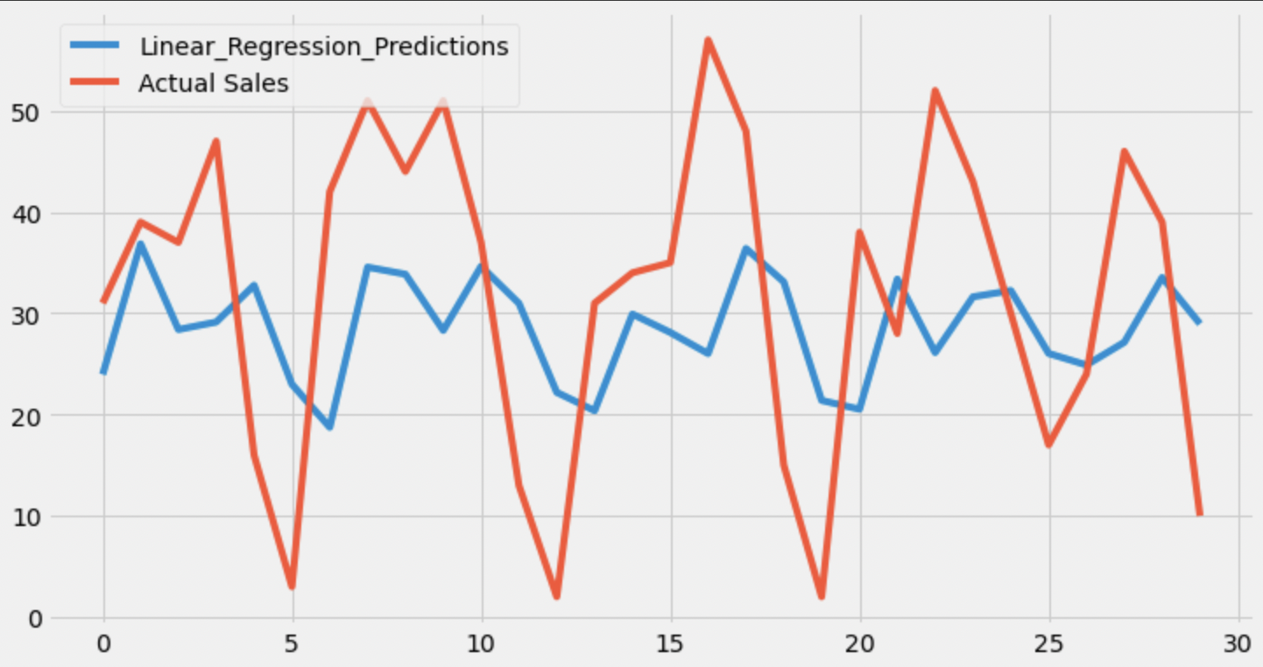
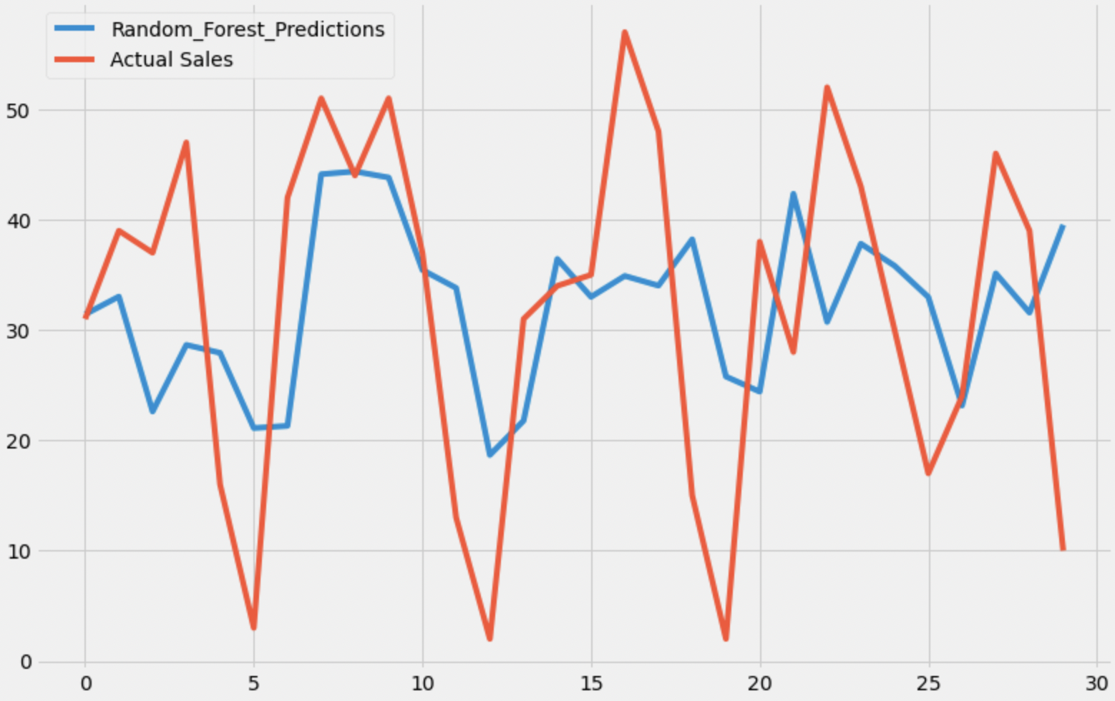
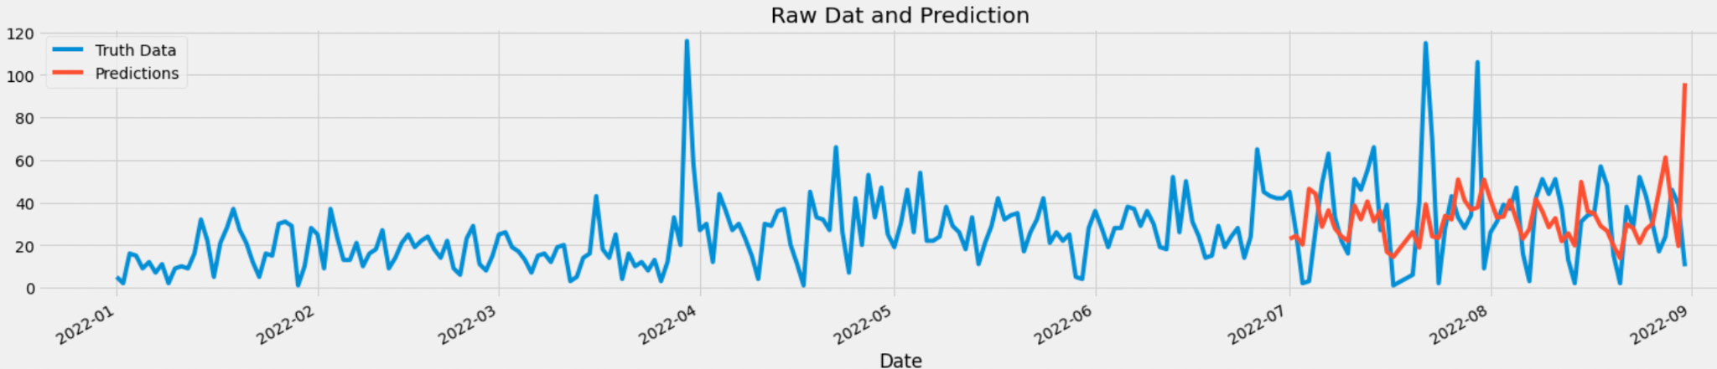
Python Predictive Modelling

Slide 12
Conclusion
ABC vending machine with 8 months dataset, improvements were achieved through some descriptive and predictive analysis.
Five fronts were maintained including:
Creating a executive Dashboard.
Creating Different graphs for monitoring
Rcoil Analysis (Most sales in that vending machine Row )
Mapping (Optimal route )
Machine learning to predict future demand

